Slide 1
LOGISTIC REGRESSION
Jasmine Wilkerson
jasmine@datasciencedojo.com

Slide 2
Classification
Two-class (binary) classification problem
y : {0,1} 0: negative class
1: positive class
Example: Yes/No; Benign/Malignant ; Click/No click
Multi-class classification problem
y:{0,1,2,…….n}
Example: Grades (A, B, C); color (red, blue, green)

Slide 3
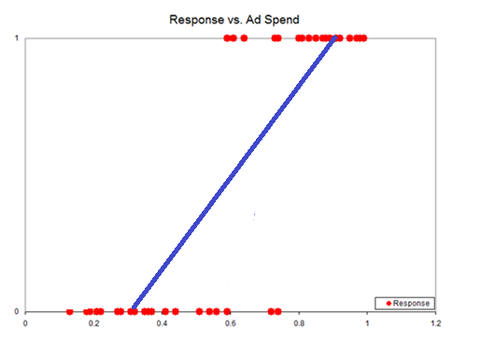
Two Class Classification
Classification: y= 0 or y=1
Decision rules: h_{θ}(x) ⪖ 0.5; y = 1
h_{θ}(x) ˂ 0.5; y = 0
If we use linear regression on classification
problem, we may observed
Shift the decision rule line
h_{θ}(x) can be > 1 or < 0

Slide 4

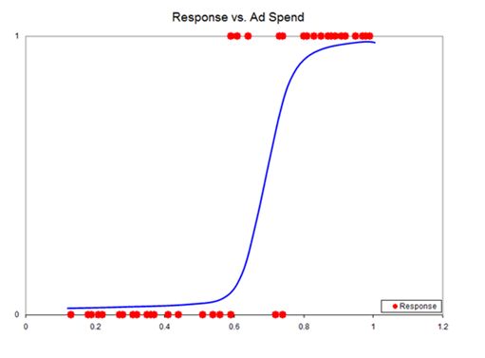

Logistic Regression
More reasonable function use for two-class classification problem.

Slide 5
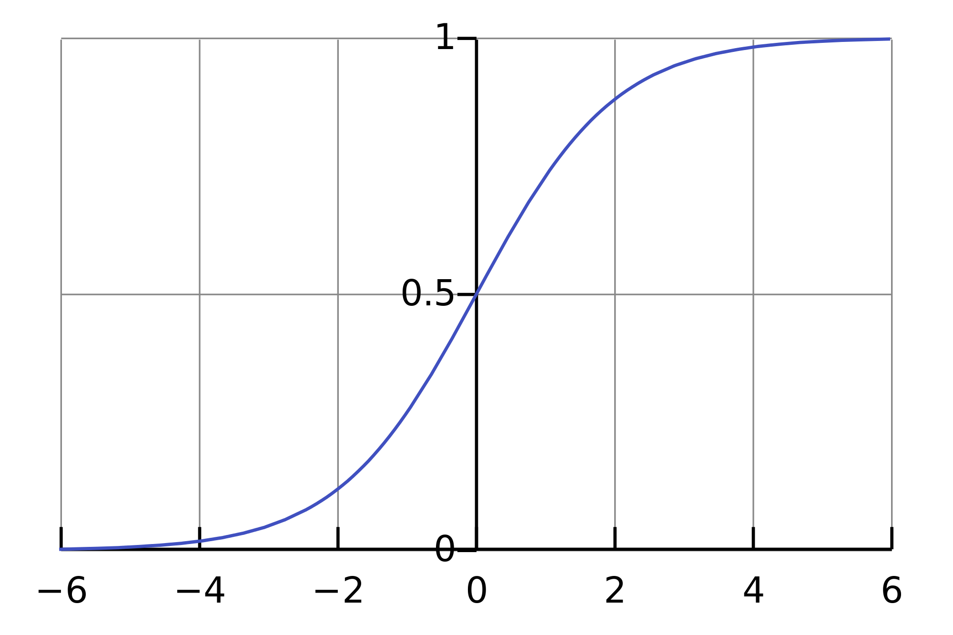
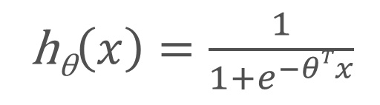
Sigmoid Function
h_{θ}$\left(x\right)=\frac{1}{1+e^{−θTx}}$
Hypothesis interpretation
Estimated probability that y=1 on x input
P(y=1| x; θ_{j} )
Because probabilities should sum to 1
P(y= 0| x; θ_{j}) = 1- P(y=1| x; θ_{j} )

Slide 6

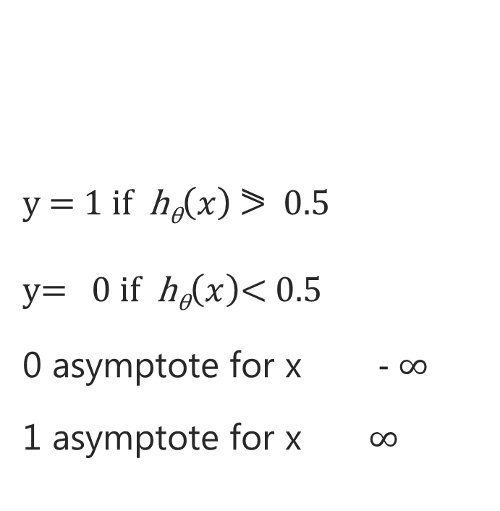
Sigmoid Function
y = 1 if h_{θ}$\left(x\right)$ ⪖ 0.5
y= 0 if h_{θ}$\left(x\right)$< 0.5
0 asymptote for x - ∞
1 asymptote for x ∞

Slide 7
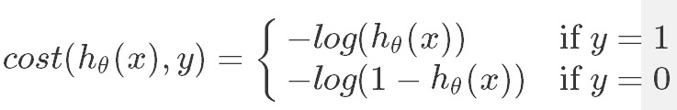
Cost Function for Logistic Regression
Average cost function

Slide 8
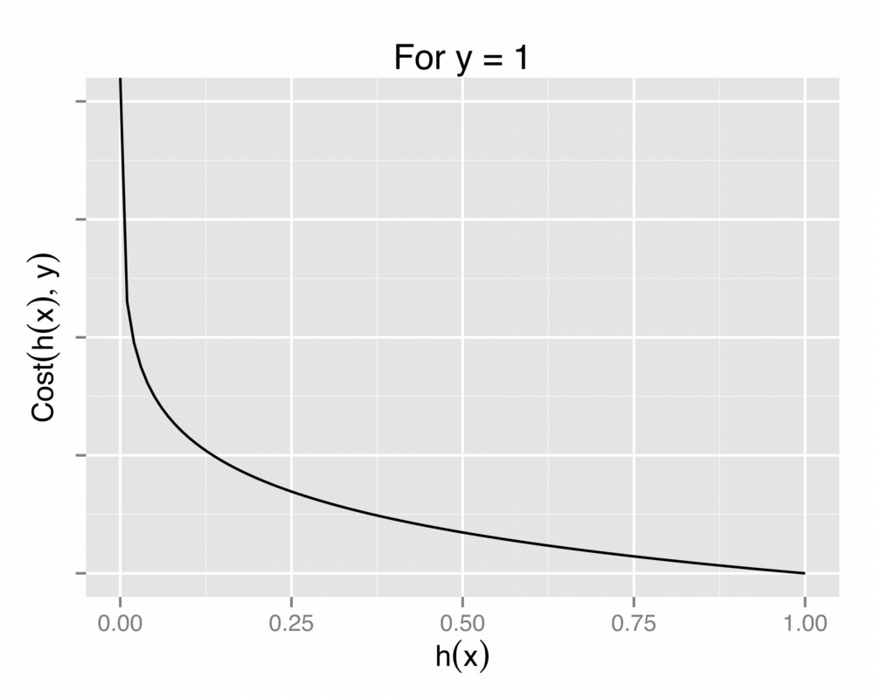
Cost Function for Logistic Regression
If we predict h_{θ}(x) = 1 and y = 1
Cost function zero
If we predict h_{θ}(x) = 0 and y =1
Cost function - ∞

Slide 9
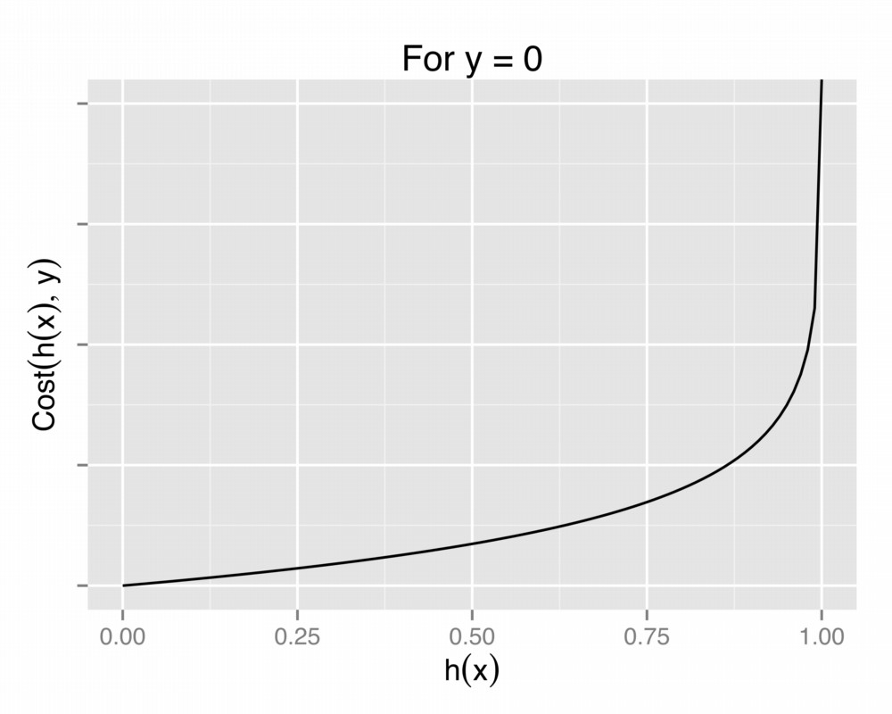
Cost Function for Logistic Regression
If we predict h_{θ}(x) = 0 and y = 0
Cost function zero
If we predict h_{θ}(x) = 1 and y =0
Cost function ∞

Slide 10

Cost Function for logistic regression
Average cost function
Simplified cost function, given we only have either y=0 or y=1

Slide 11

Cost Function: Recap
Hypothesis:
Cost Function:
Parameters:
Goal:
θ_{j}

Slide 12

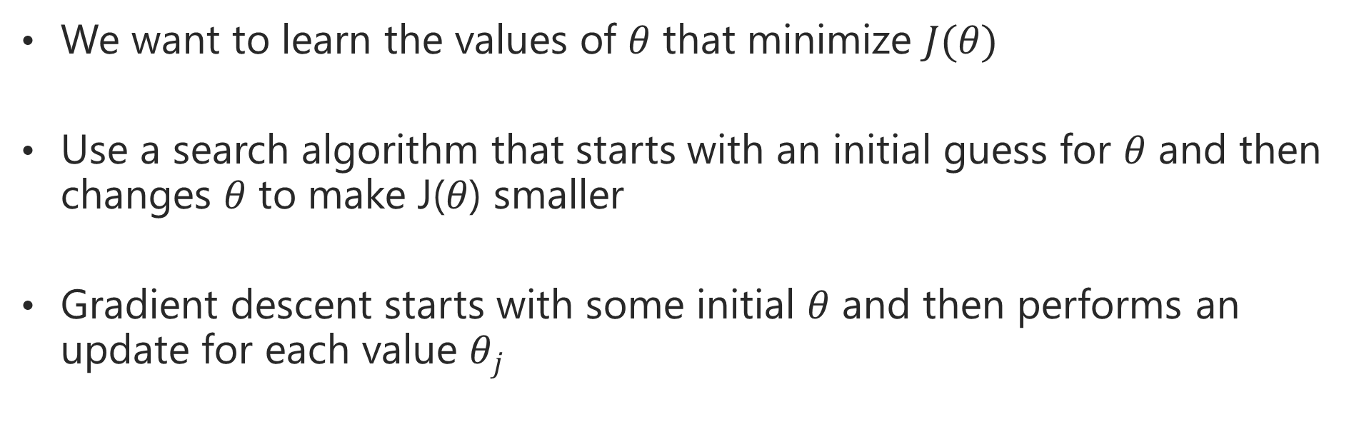
Gradient Descent Algorithm
We want to learn the values of $θ$ that minimize $J(θ)$
Use a search algorithm that starts with an initial guess for $θ$ and then changes $θ$ to make J($θ$) smaller
Gradient descent starts with some initial $θ$ and then performs an update for each value $θ_{j}$
Notes:
Will demostrate the derivative of J(theta)

Slide 13

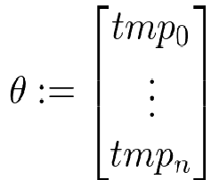

Minimizing The Cost Function J$(θ)$
After derivative
Repeat until converged

Slide 14
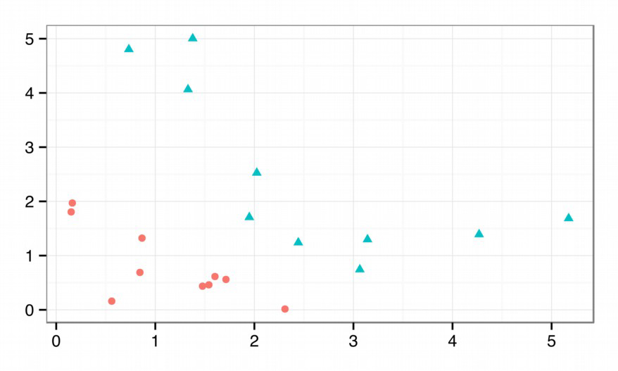

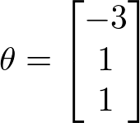
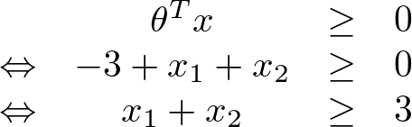
Decision Boundary: Linear
If
And
Prediction y = 1 whenever

Slide 15
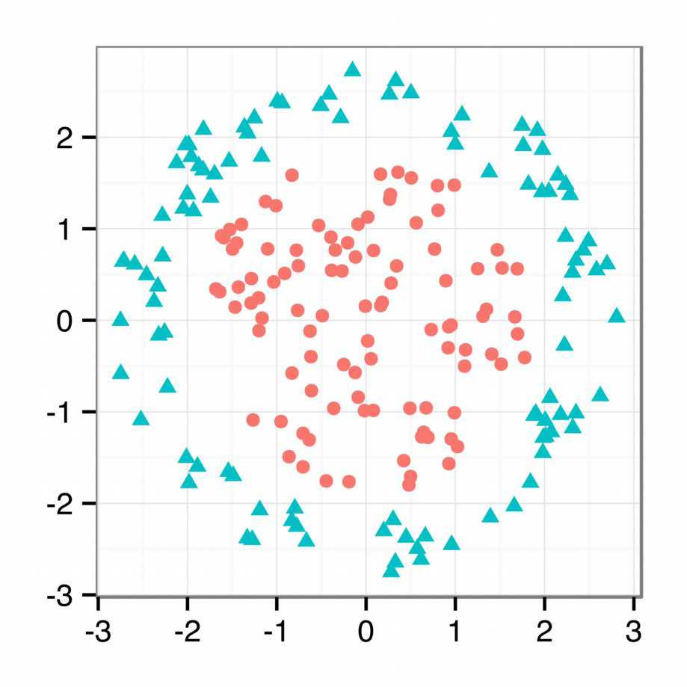



Decision Boundary: Non-Linear
If
And
Prediction y = 1 whenever

Slide 16
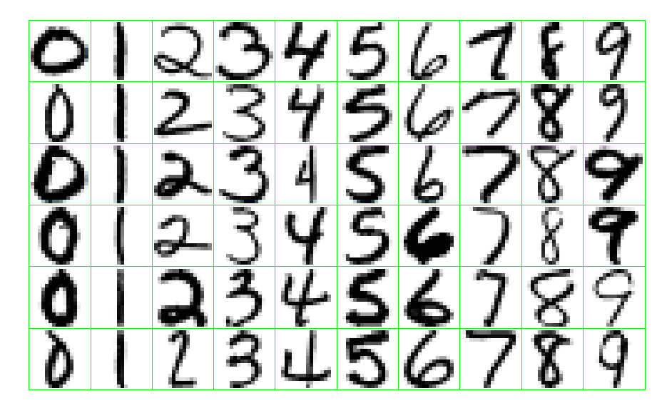
Example: Handwritten Digit Recognition

Slide 17
Questions?

